Slide 1
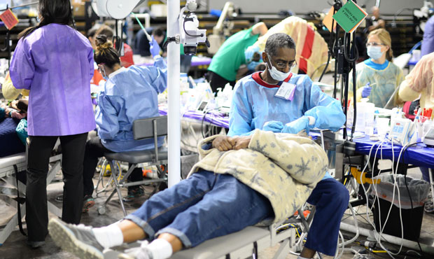

Efficient Insurance
Team 302
Issue: Most are uninformed about healthcare benefits + Inability to find a healthcare provider in a timely manner
1. What your health insurance covers
2. What you can do/How you can apply your insurance plan
Our idea:
Develop trust in the individual that their health insurance plan will meet their needs in a timely manner and at minimal costs
An app where users can choose the most fitting insurance plan based on their short- and long-term needs (urgency, costs, availability…), and be able to choose from the best available option of health service recommended to them.
Interconnectedness between all parties on one platform allows easier access to adequate insurance and efficient services.
Government
Insurance Company
Employer
User

Slide 2
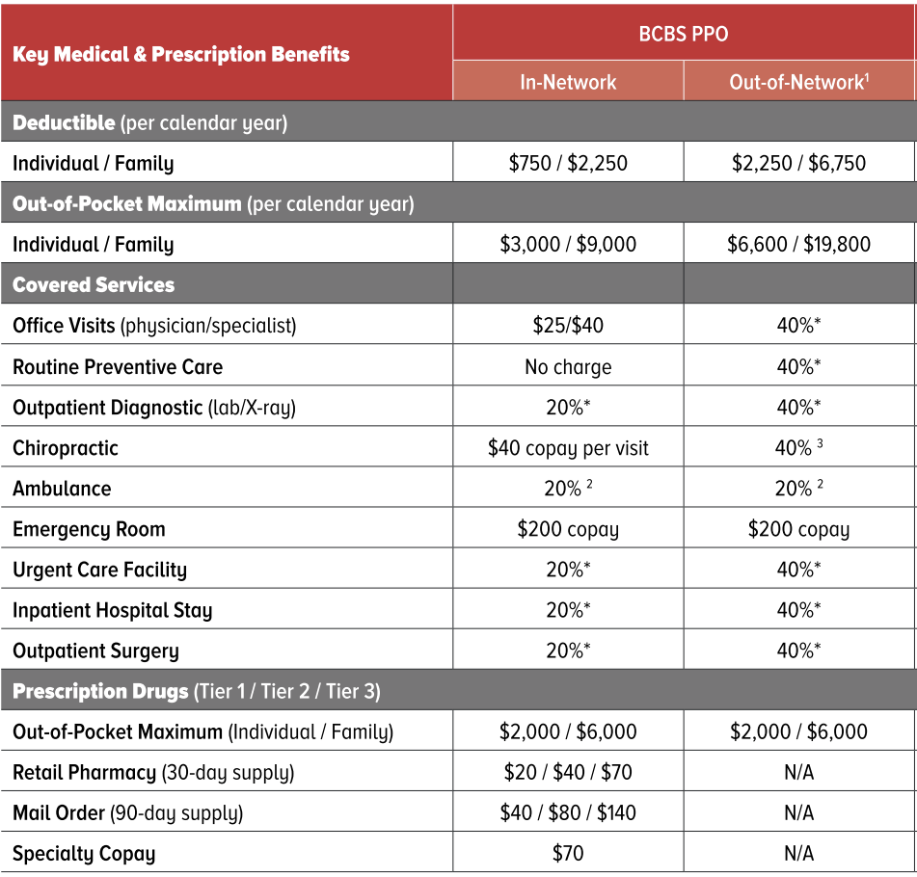
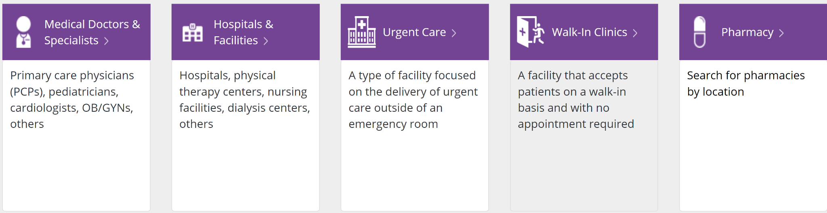

User Experience (Simplified)
Team 302
Smith John, MD
Plan: PPO
~2.1 miles
Available in 3 days
Costs
Bilingual
CVS Minute Clinic
Plan: HMO
~1.2 miles
Hours
Insurance Condition
Insurance Plan
Provider
More specifics:
-time/urgency
-availability
-costs -cultural values

